Slide 1
The Year of Electric Embodiment
An Archetypal / Evolutionary Perspective for 2018

Slide 4
Radical Restructuring: The Re-Membering of the Sacredness of Saturn & Form

Slide 5
Key 2018 Energies:
♃ ♏ / ♐
♄ ♑
♅ ♉ / ♈
♇ ♑
☊ ♌ / ♋
☋ ♒ / ♑
(Lack of outer planet transits [♃ Trine ♆; ♃ Sextile ♇; ♂ Square ♅])

Slide 6
KEY 2018 THEMES:
Practicality
Austerity & Militarism – BE PREPARED
Alignment of Will with Heart
New Foundations
“You Reap What You Sew”
Groundedness
Recognition of Personal Authority/Sovereignty
Speaking Truth to Power
Confrontations with Authority
Fluctuations in Authoritarian/Governmental Structures
Critical Analysis of “New Age” Spirituality (and other “disembodied” philosophies)
Epigenetic/Ancestral Healing
Unsettling/”Wake Up Call” to Neglect of Form [structural issues, including health, home, car, finances, etc.]
Re-Membering of Sacred Earth/Sacred Body
Deeper understanding & acceptance of energetics, herbalism, & healing
Potent Physical Healing Period (though prone to “healing crises” - ♅ ♉)
Shifting Values RE: The Material (including, especially, economically)

Slide 9
2018 MARS
Retrograde Cycle:
♂
2018 VENUS
Retrograde Cycle:
♀
☿
2018 MERCURY
Retrograde Cycles = FIRE
Images Source: https://cafeastrology.com/astrologyof2018horoscopes.html

Slide 10
A Return to Earth:
Year of the Earth Dog
Saturn in Capricorn
January 2018: Capricorn Stelliums
Uranus Enters Taurus

Slide 11
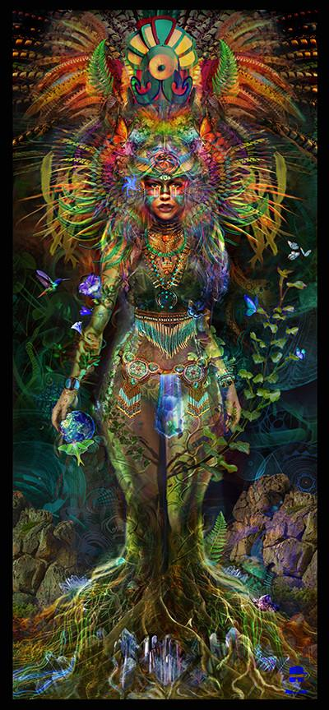
How to Balance?
Nervines
Scullcap, Chamomile, Lavender, Tulsi (Holy Basil), Lemon Balm, Etc.
Medicinal Mushrooms
ESPECIALLY:
Cordyceps
Lion’s Mane
Turkey Tail
BOOST IMMUNITY
Acupuncture / Energy Healing (Uranus-Taurus)
Physical Exercise – especially those focusing on structural alignment (i.e. Iyengar Yoga)
Bone Broth
Gold, Copper, Citrine, Pyrite, Rose Quartz, Carnelian, Amber
Sunflowers, Roses, Flowers
Eroticism
Affection

